Slide 1
Working with text data
Preparing text for large language model training
Splitting text into word and subword tokens
Byte pair encoding as a more advanced way of tokenizing text
Sampling training examples with a sliding window approach
Converting tokens into vectors that feed into a large language model

Slide 2
LLM Models
So far, we’ve covered the general structure of large language models (LLMs) and learned that they are pretrained on vast amounts of text.
Specifically, our focus was on decoder-only LLMs based on the transformer architecture, which underlies the models used in ChatGPT and other popular GPT-like LLMs.
During the pretraining stage, LLMs process text one word at a time.

Slide 3
Training LLMs
Training LLMs with millions to billions of parameters using a next-word prediction task yields models with impressive capabilities.
These models can then be further finetuned to follow general instructions or perform specific target tasks.
But before we can implement and train LLMs, we need to prepare the training dataset, as illustrated in figure 2.1.

Slide 4
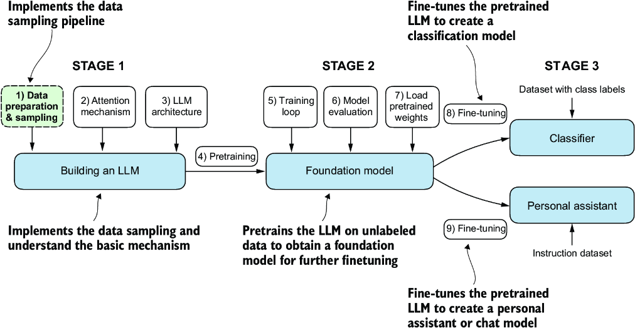
Figure 2.1 The three main stages of coding an LLM

Slide 5
Preparing input text for training LLMs
This involves splitting text into individual word and subword tokens, which can then be encoded into vector representations for the LLM.
You’ll also learn about advanced tokenization schemes like byte pair encoding, which is utilized in popular LLMs like GPT.
Lastly, we’ll implement a sampling and data-loading strategy to produce the input-output pairs necessary for training LLMs.

Slide 6
Understanding word embeddings
Deep neural network models, including LLMs, cannot process raw text directly.
Since text is categorical, it isn’t compatible with the mathematical operations used to implement and train neural networks.
Therefore, we need a way to represent words as continuous-valued vectors.
The concept of converting data into a vector format is often referred to as embedding.

Slide 7
Embedding
Using a specific neural network layer or another pretrained neural network model, we can embed different data types
for example, video, audio, and text, as illustrated in figure 2.2.
However, it’s important to note that different data formats require distinct embedding models.
For example, an embedding model designed for text would not be suitable for embedding audio or video data.

Slide 8
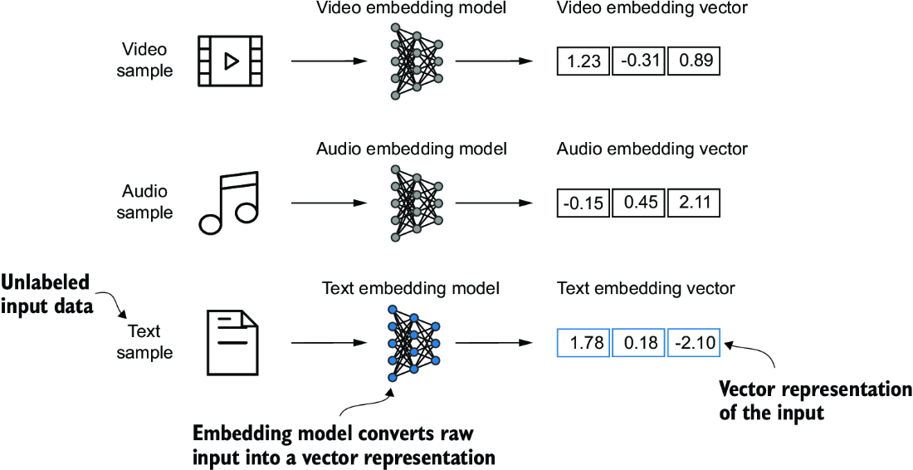
Figure 2.2 Vector Representation
Deep learning models cannot process data formats like video, audio, and text in their raw form.
Thus, we use an embedding model to transform this raw data into a dense vector representation that deep learning architectures can easily understand and process.
Specifically, this figure illustrates the process of converting raw data into a 3-dimensional numerical vector.

Slide 9
Primary Purpose of Embeddings
At its core, an embedding is a mapping from discrete objects, such as words, images, or even entire documents, to points in a continuous vector space—the primary purpose of embeddings is to convert nonnumeric data into a format that neural networks can process.
While word embeddings are the most common form of text embedding, there are also embeddings for sentences, paragraphs, or whole documents.
Sentence or paragraph embeddings are popular choices for retrieval-augmented generation.

Slide 10
Retrieval-augmented generation
Retrieval-augmented generation combines generation (like producing text) with retrieval (like searching an external knowledge base) to pull relevant information when generating text, which is a technique that is beyond the scope of this class.
Since our goal is to train GPT-like LLMs, which learn to generate text one word at a time, we will focus on word embeddings.

Slide 11
Algorithms
Several algorithms and frameworks have been developed to generate word embeddings.
One of the earlier and most popular examples is the Word2Vec approach.
Word2Vec trained neural network architecture to generate word embeddings by predicting the context of a word given the target word or vice versa.
The main idea behind Word2Vec is that words that appear in similar contexts tend to have similar meanings.
Consequently, when projected into two-dimensional word embeddings for visualization purposes, similar terms are clustered together, shown in figure 2.3

Slide 12
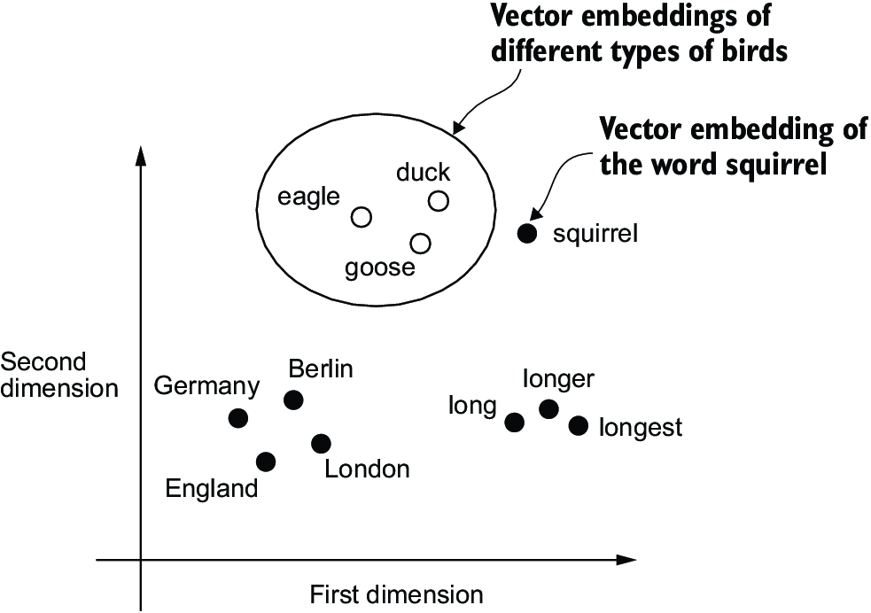
Figure 2.3 Two-dimensional scatterplot for visualization
If word embeddings are two-dimensional, we can plot them in a two-dimensional scatterplot for visualization purposes as shown here.
When using word embedding techniques, such as Word2Vec, words corresponding to similar concepts often appear close to each other in the embedding space.
For instance, different types of birds appear closer to each other than in countries and cities.

Slide 13
Word embeddings can have varying dimensions
Word embeddings can have varying dimensions, from one to thousands.
A higher dimensionality might capture more nuanced relationships but at the cost of computational efficiency.
While we can use pretrained models such as Word2Vec to generate embeddings for machine learning models, LLMs commonly produce their own embeddings that are part of the input layer and are updated during training.

Slide 14
Embeddings are optimized to the specific task and data at hand
The advantage of optimizing the embeddings as part of the LLM training instead of using Word2Vec is that the embeddings are optimized to the specific task and data at hand.
We will implement such embedding layers later.
LLMs can also create contextualized output embeddings, as we discuss in the next lecture.

Slide 15
High-dimensional embeddings present a challenge
Unfortunately, high-dimensional embeddings present a challenge for visualization because our sensory perception and common graphical representations are inherently limited to 3 dimensions or fewer.
This is why figure 2.3 shows 2-dimensional embeddings in a 2-dimensional plot
However, when working with LLMs, we typically use embeddings with a much higher dimensionality.
For both GPT-2 and GPT-3, the embedding size (often referred to as the dimensionality of the model’s hidden states) varies based on the specific model variant and size.
It is a tradeoff between performance and efficiency.

Slide 16
Embedding Size
The smallest GPT-2 models (117M and 125M parameters) use an embedding size of 768 dimensions to provide concrete examples.
The largest GPT-3 model (175B parameters) uses an embedding size of 12,288 dimensions.

Slide 17
Tokenizing text
Let’s discuss how we split input text into individual tokens, a required preprocessing step for creating embeddings for an LLM.
These tokens are either individual words or special characters, including punctuation characters, as shown in figure 2.4.

Slide 18
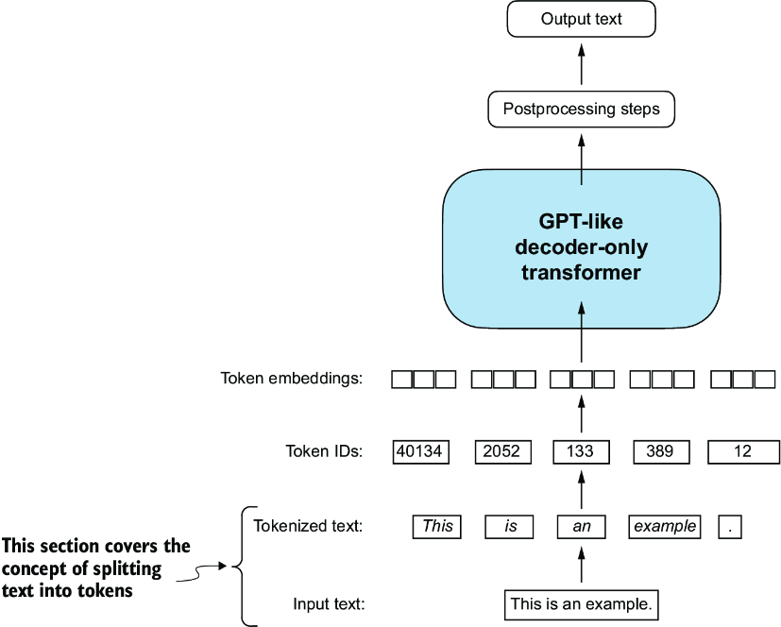
Figure 2.4 View of the text processing steps in the context of an LLM
Here, we split an input text into individual tokens, which are either words or special characters, such as punctuation characters.

Slide 19
The text to be tokenized for LLM training
The text we will tokenize for LLM training is “The Verdict,” a short story by Edith Wharton, which has been released into the public domain and is thus permitted to be used for LLM training tasks.
The text is available on Wikisource at https://en.wikisource.org/wiki/The_Verdict and you can copy-paste it into a text file "the-verdict.txt".
Alternatively, you can find this "the-verdict.txt" file in this book’s GitHub repository at https://mng.bz/Adng

Slide 20
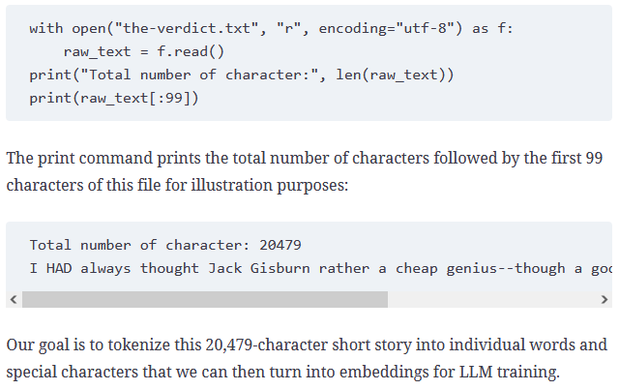
Listing 2.1 Reading in a short story as text sample

Slide 21
How can we best split this text to obtain a list of tokens?
It’s common to process millions of articles and hundreds of thousands of books—many gigabytes of text—when working with LLMs.
However, for educational purposes, it’s sufficient to work with smaller text samples like a single book to illustrate the main ideas behind the text processing steps and to make it possible to run it in a reasonable time on consumer hardware.
How can we best split this text to obtain a list of tokens?
For this, we go on a small excursion and use Python’s regular expression library re for illustration purposes.

Slide 22
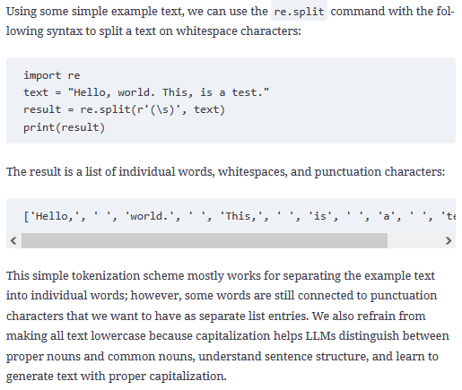

Slide 23
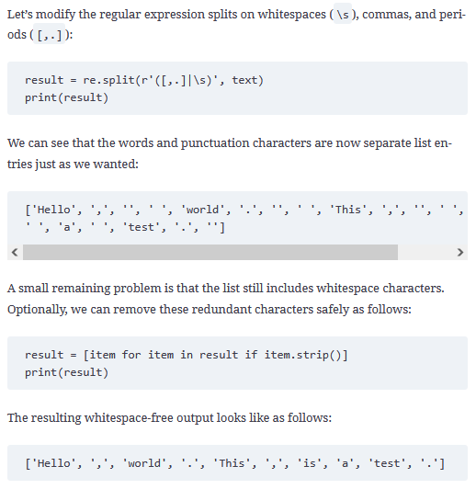

Slide 24
Encoding whitespaces as separate characters
When developing a simple tokenizer, whether we should encode whitespaces as separate characters or just remove them depends on our application and its requirements.
Removing whitespaces reduces the memory and computing requirements.
However, keeping whitespaces can be useful if we train models that are sensitive to the exact structure of the text (for example, Python code, which is sensitive to indentation and spacing).
Here, we remove whitespaces for simplicity and brevity of the tokenized outputs.
Later, we will switch to a tokenization scheme that includes whitespaces.

Slide 25
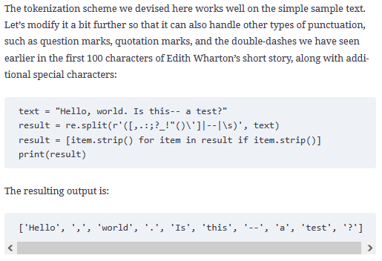

Slide 26
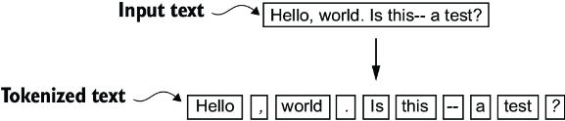
Figure 2.5 The tokenization scheme
As we can see based on the results summarized above, the tokenization scheme can now handle the various special characters in the text successfully.
The tokenization scheme we implemented so far splits text into individual words and punctuation characters.
In this specific example, the sample text gets split into 10 individual tokens.

Slide 27
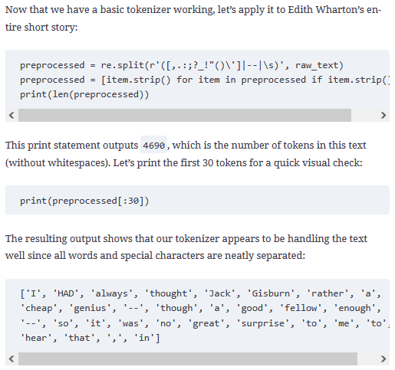

Slide 28
Converting tokens into token IDs
Next, let’s convert these tokens from a string to an integer representation to produce the token IDs.
This conversion is an intermediate step before converting the token IDs into embedding vectors.
To map the previously generated tokens into token IDs, we have to build a vocabulary first.
This vocabulary defines how we map each unique word and special character to a unique integer, as shown in figure 2.6.

Slide 29
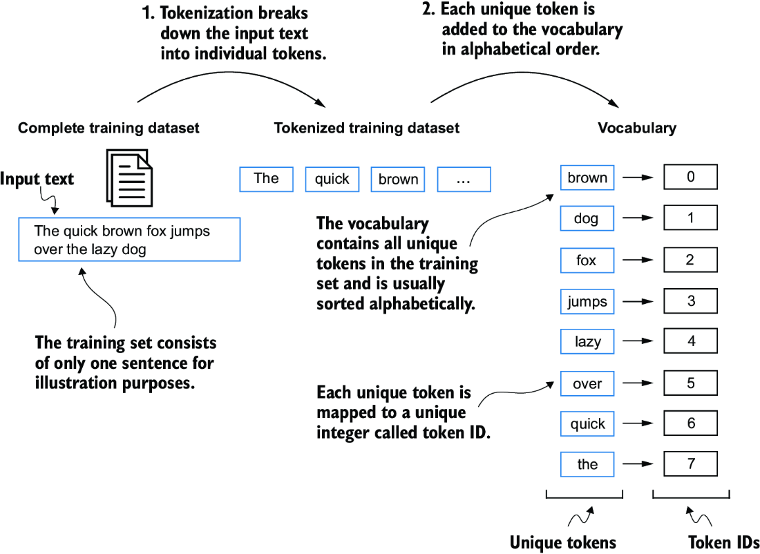
Figure 2.6 Building a vocabulary by tokenizing the entire text
We build a vocabulary by tokenizing the entire text in a training dataset into individual tokens.
These individual tokens are then sorted alphabetically, and duplicate tokens are removed.
The tokens are then aggregated into a vocabulary to map each unique token to a unique integer value.
The vocabulary is purposely small and contains no punctuation or special characters for simplicity.

Slide 30
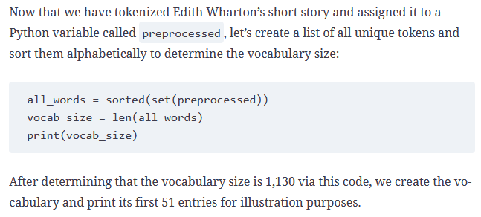
Creating a list of unique tokens

Slide 31
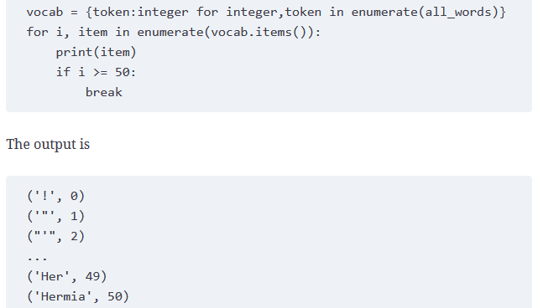
Listing 2.2 Creating a vocabulary
As we can see, the dictionary contains individual tokens associated with unique integer labels. Our next goal is to apply this vocabulary to convert new text into token IDs (figure 2.7).

Slide 32
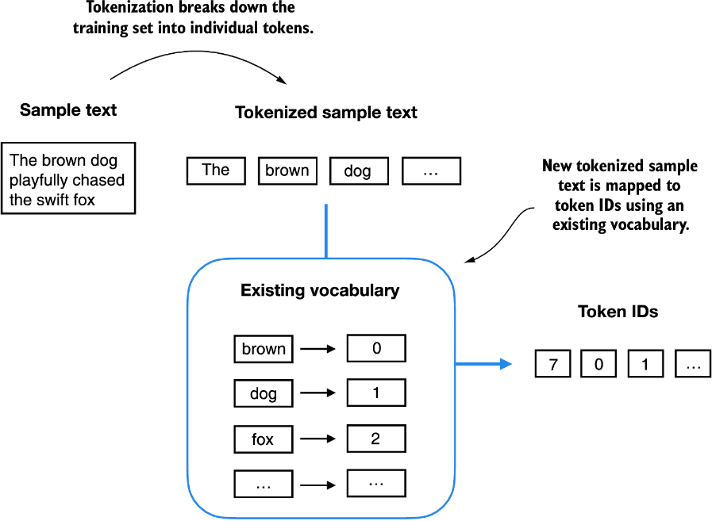
Figure 2.7 Converting the text tokens into token IDs
The vocabulary is built from the entire training set and can be applied to the training set itself and any new text.
The depicted vocabulary contains no punctuation or special characters for simplicity.

Slide 33
Inverse Version
When we want to convert the outputs of an LLM from numbers back into text, we need a way to turn token IDs into text.
For this, we can create an inverse version of the vocabulary that maps token IDs back to the corresponding text tokens.
Let’s implement a complete tokenizer class with an encode method that splits text into tokens and carries out the string-to-integer mapping to produce token IDs via the vocabulary.
In addition, we’ll implement a decode method that carries out the reverse integer-to-string mapping to convert the token IDs back into text.

Slide 34
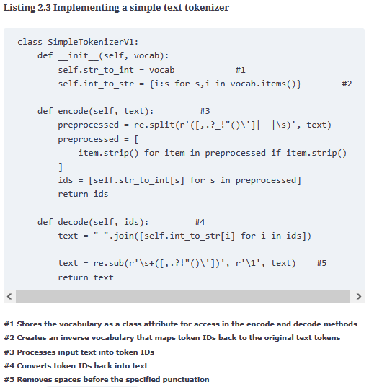

Slide 35
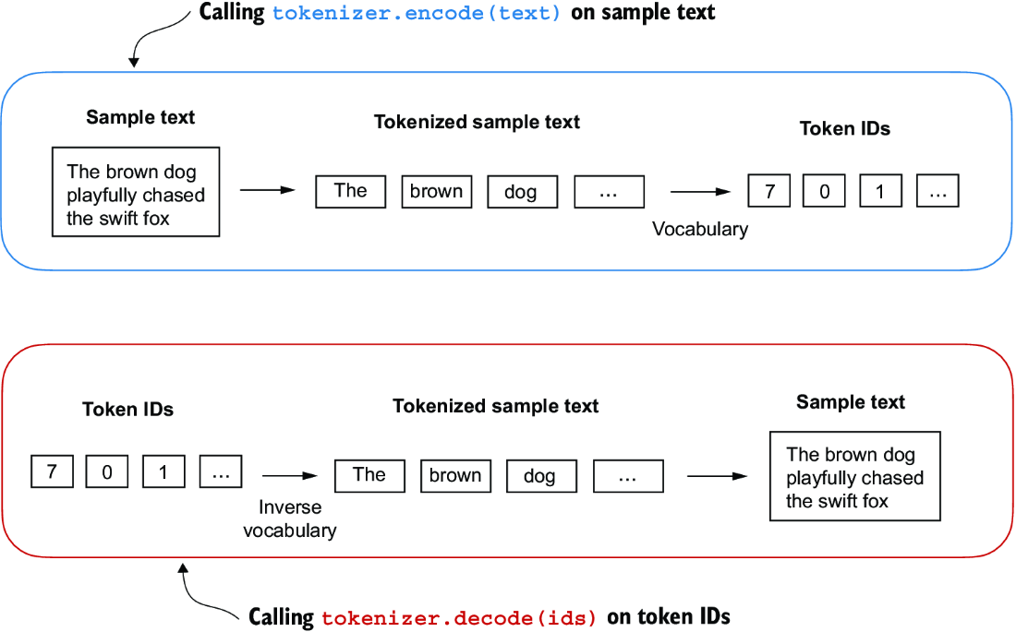
Figure 2.8 Encode and Decode Methods
encode(text) splits the text into individual tokens, and converts the tokens into token IDs via the vocabulary.
decode(ids) converts the token IDs back into text tokens, and concatenates the text tokens into natural text.

Slide 36
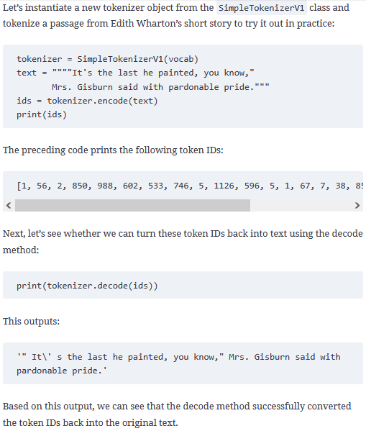

Slide 38
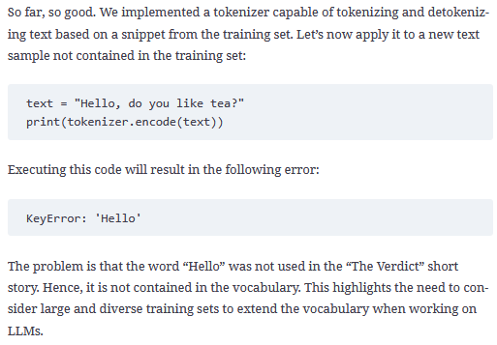

Slide 39
Adding special context tokens
We need to modify the tokenizer to handle unknown words.
We also need to address the usage and addition of special context tokens that can enhance a model’s understanding of context or other relevant information in the text.
These special tokens can include markers for unknown words and document boundaries, for example.
In particular, we will modify the vocabulary and tokenizer, SimpleTokenizerV2, to support two new tokens, <|unk|> and <|endoftext|>, as illustrated in figure 2.9.

Slide 40
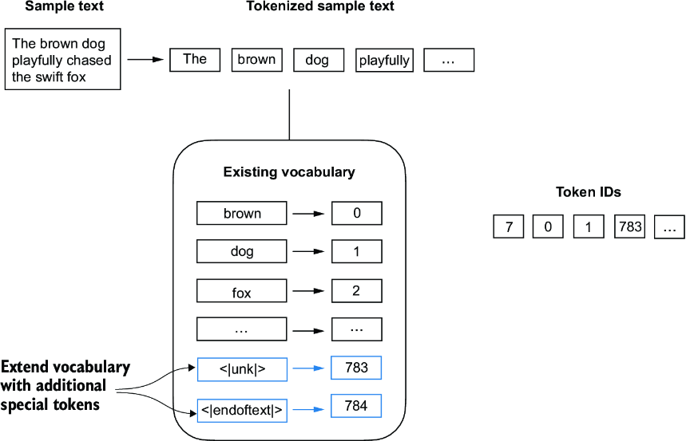
Figure 2.9 Adding special tokens to a vocabulary
We add an <|unk|> token to represent new and unknown words that were not part of the training data.
Furthermore, we add an <|endoftext|> token that we can use to separate two unrelated text sources.

Slide 41
<|unk|> token
We can modify the tokenizer to use an <|unk|> token if it encounters a word that is not part of the vocabulary.
Furthermore, we add a token between unrelated texts.
For example, when training GPT-like LLMs on multiple independent documents or books, it is common to insert a token before each document or book that follows a previous text source, as illustrated in figure 2.10.
This helps the LLM understand that although these text sources are concatenated for training, they are, in fact, unrelated.

Slide 42
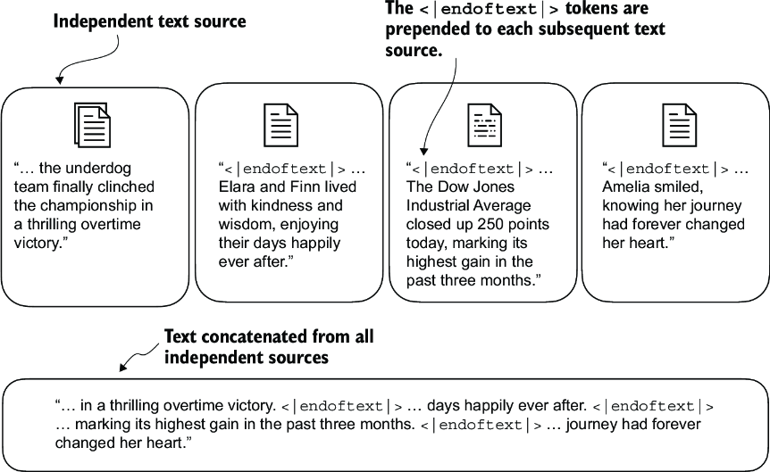
Figure 2.10 <|endoftext|> token between multiple text sources
When working with multiple independent text source, we add <|endoftext|> tokens between these texts. These <|endoftext|> tokens act as markers, signaling the start or end of a particular segment.
This allows for more effective processing and understanding by the LLM.

Slide 43
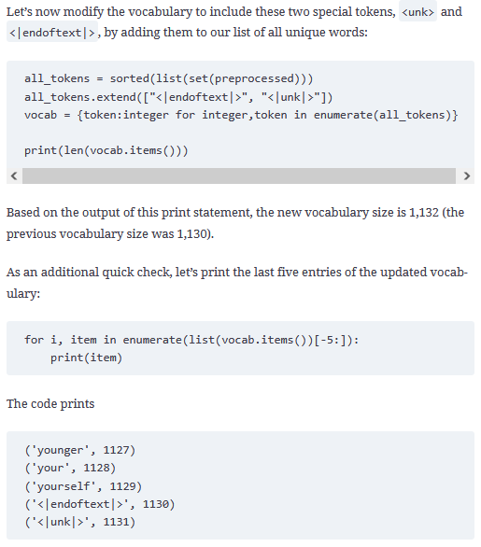

Slide 44
Based on the code output, we can confirm that the two new special tokens were indeed successfully incorporated into the vocabulary.

Slide 45
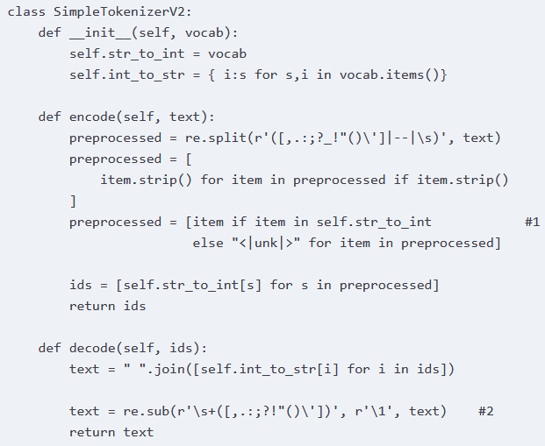
Listing 2.4 A simple text tokenizer that handles unknown words
#1 Replaces unknown words by <|unk|> tokens #2 Replaces spaces before the specified punctuations

Slide 46
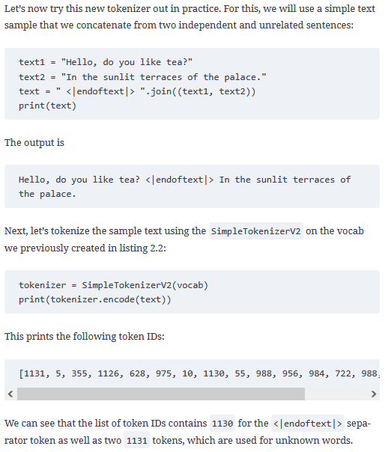

Slide 48
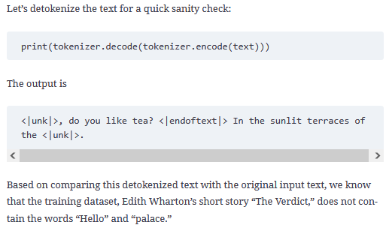

Slide 49
Some researchers also consider additional special tokens
[BOS] (beginning of sequence)
This token marks the start of a text.
It signifies to the LLM where a piece of content begins.
[EOS] (end of sequence)
This token is positioned at the end of a text and is especially useful when concatenating multiple unrelated texts, similar to <|endoftext|>.
For instance, when combining two different Wikipedia articles or books, the [EOS] token indicates where one ends and the next begins.
[PAD] (padding)
When training LLMs with batch sizes larger than one, the batch might contain texts of varying lengths.
To ensure all texts have the same length, the shorter texts are extended or “padded” using the [PAD] token, up to the length of the longest text in the batch.

Slide 50
Tokens in GPT models
The tokenizer used for GPT models does not need any of these tokens; it only uses an <|endoftext|> token for simplicity.
<|endoftext|> is analogous to the [EOS] token.
<|endoftext|> is also used for padding.
However, as we’ll explore in subsequent lectures, when training on batched inputs, we typically use a mask, meaning we don’t attend to padded tokens.
Thus, the specific token chosen for padding becomes insignificant.

Slide 51
The Tokenizer used for GPT Models
Moreover, the tokenizer used for GPT models also doesn’t use an <|unk|> token for out-of-vocabulary words.
Instead, GPT models use a byte pair encoding tokenizer, which breaks words down into subword units, which we will discuss next.

Slide 52
Tokenization
Natural Language Processing (NLP) is a subfield of artificial intelligence that gives the ability to machine understand and process human languages.
Tokenization is the process of dividing the text into a collection of tokens from a string of text.
Tokenization is often the first step in natural language processing tasks such as text classification, named entity recognition, and sentiment analysis.
The resulting tokens are typically used as input to further processing steps, such as vectorization, where the tokens are converted into numerical representations for machine learning models to use.
The BPE tokenizer was used to train LLMs such as GPT-2, GPT-3, and the original model used in ChatGPT.

Slide 53
Byte-Pair Encoding (BPE) is a compression algorithm
BPE is a compression algorithm used in Natural Language Processing (NLP) to represent large vocabulary with a small set of subword units.
It was introduced by Sennrich et al. in 2016 and has been widely used in various NLP tasks such as machine translation, text classification, and text generation.
The basic idea of BPE is to iteratively merge the most frequent pair of consecutive bytes or characters in a text corpus until a predefined vocabulary size is reached.
The resulting subword units can be used to represent the original text in a more compact and efficient way.

Slide 54
Concepts related to BPE:
Vocabulary:
A set of subword units that can be used to represent a text corpus.
Byte:
A unit of digital information that typically consists of eight bits.
Character:
A symbol that represents a written or printed letter or numeral.
Frequency:
The number of times a byte or character occurs in a text corpus.
Merge:
The process of combining two consecutive bytes or characters to create a new subword unit.

Slide 55
Steps involved in BPE:
Initialize the vocabulary with all the bytes or characters in the text corpus
Calculate the frequency of each byte (or character) in the text corpus.
Repeat the following steps until the desired vocabulary size is reached:
Find the most frequent pair of consecutive bytes in the text corpus
Merge the pair to create a new subword unit
Update the frequency counts of all the bytes containing the merged pair
Add the new subword unit to the vocabulary
Represent the text corpus using the subword units in the vocabulary.

Slide 56
How Byte-Pair Encoding (BPE) works:
Suppose we have a text corpus with the following four words: “ab”, “bc”, “bcd”, and “cde”.
The initial vocabulary consists of all the bytes or characters in the text corpus: {“a”, “b”, “c”, “d”, “e”}.

Slide 57
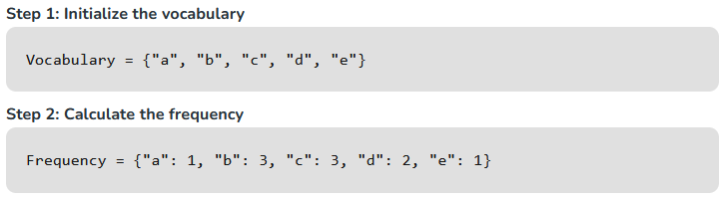

Slide 58
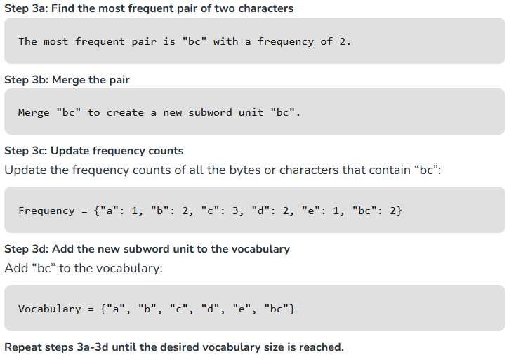

Slide 59
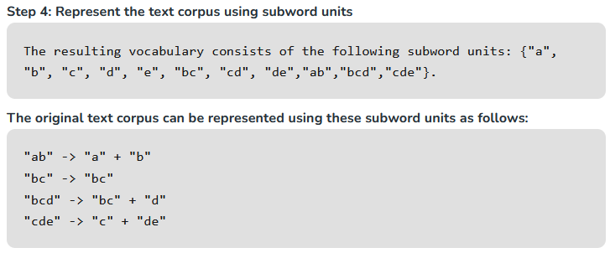

Slide 60
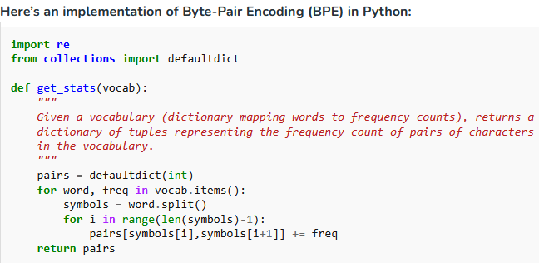

Slide 61
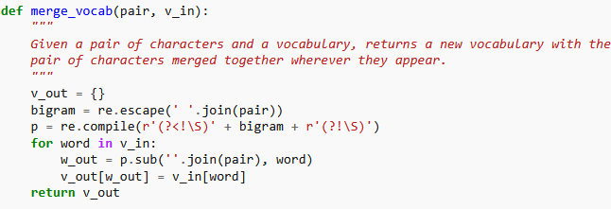

Slide 62
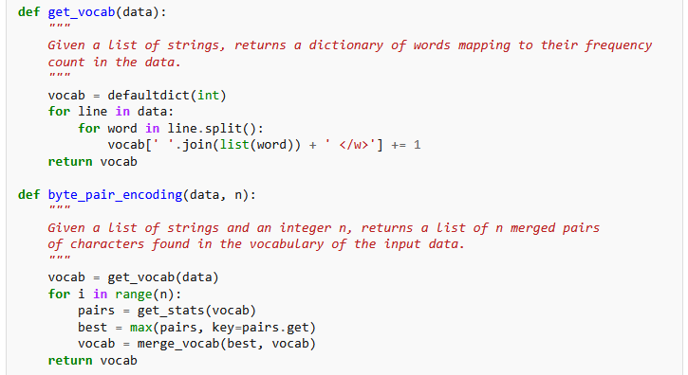

Slide 63
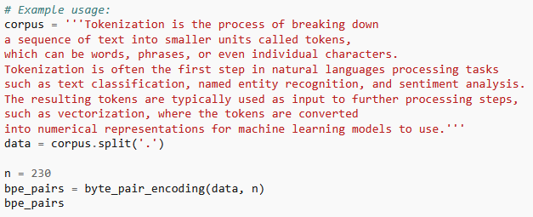

Slide 64
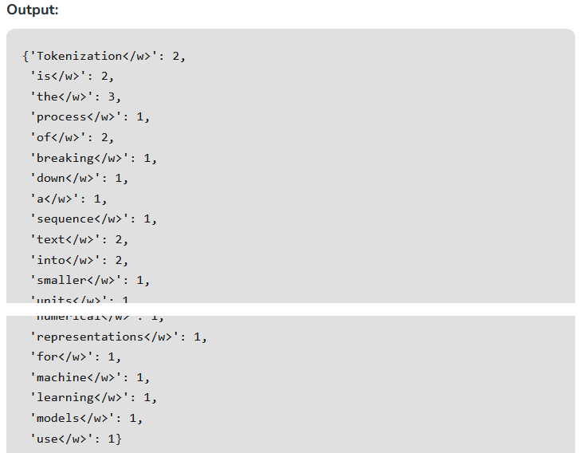

Slide 65
The output represents the frequency count
The output represents the frequency count of merged pairs of characters found in the given corpus using byte pair encoding (BPE) with 230 iterations.
Each key-value pair in the dictionary indicates a merged pair of characters along with its frequency count in the corpus.
This process iteratively merges the most frequent pair of characters until the specified number of iterations is reached.

Slide 66
BPE Algorithm
The algorithm underlying BPE breaks down words that aren’t in its predefined vocabulary into smaller subword units or even individual characters, enabling it to handle out-of-vocabulary words.
So, thanks to the BPE algorithm, if the tokenizer encounters an unfamiliar word during tokenization, it can represent it as a sequence of subword tokens or characters, as illustrated in figure 2.11.

Slide 67
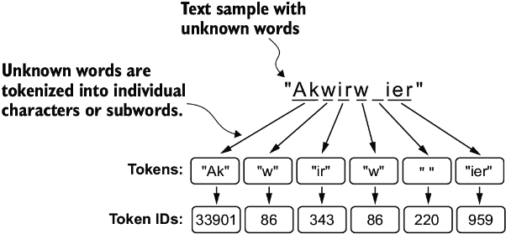
Figure 2.11 BPE breaks down unknown words into subwords
BPE tokenizers break down unknown words into subwords and individual characters.
This way, a BPE tokenizer can parse any word and doesn’t need to replace unknown words with special tokens, such as <|unk|>.
The ability to break down unknown words into individual characters ensures that the tokenizer and, consequently, the LLM that is trained with it can process any text, even if it contains words that were not present in its training data.

Slide 68
BPE builds its vocabulary
BPE builds its vocabulary by iteratively merging frequent characters into subwords and frequent subwords into words.
For example, BPE starts with adding all individual single characters to its vocabulary (“a,” “b,” etc.).
In the next stage, it merges character combinations that frequently occur together into subwords.
For example, “d” and “e” may be merged into the subword “de,” which is common in many English words like “define,” “depend,” “made,” and “hidden.”
The merges are determined by a frequency cutoff.

Slide 69
Data sampling with a sliding window
The next step in creating the embeddings for the LLM is to generate the input–target pairs required for training an LLM.
What do these input–target pairs look like? As we already learned, LLMs are pretrained by predicting the next word in a text, as depicted in figure 2.12.

Slide 70
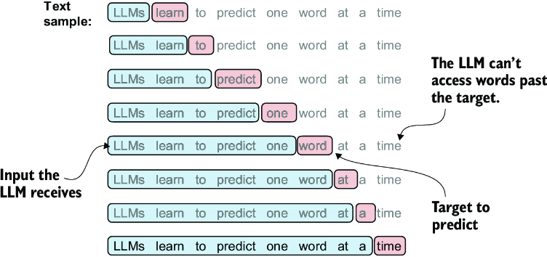
Figure 2.12 LLM’s prediction task during training is to predict the next word
Given a text sample, extract input blocks as subsamples that serve as input to the LLM, and the LLM’s prediction task during training is to predict the next word that follows the input block.
During training, we mask out all words that are past the target.
Note that the text shown in this figure must undergo tokenization before the LLM can process it; however, this figure omits the tokenization step for clarity.

Slide 71
Creating token embeddings
The last step in preparing the input text for LLM training is to convert the token IDs into embedding vectors, as shown in figure 2.15.
As a preliminary step, we must initialize these embedding weights with random values.
This initialization serves as the starting point for the LLM’s learning process.
In the following lectures, we will optimize the embedding weights as part of the LLM training.

Slide 72
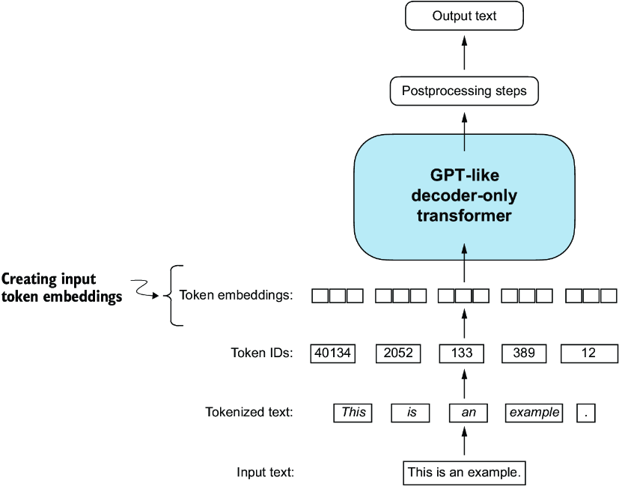
Figure 2.15 Converting token IDs into embedding vectors
Preparation involves tokenizing text, converting tokens to IDs, and converting IDs into embedding vectors
Here, we consider the previously created token IDs to create the token embedding vectors.

Slide 73
Embedding is necessary
A continuous vector representation, or embedding, is necessary since GPT-like LLMs are deep neural networks trained with the backpropagation algorithm.

Slide 74
Word Embeddings
Word Embeddings are numeric representations of words in a lower-dimensional space, capturing semantic and syntactic information.
They play a vital role in Natural Language Processing (NLP) tasks.

Slide 75
What is Word Embedding in NLP?
Word Embedding is an approach for representing words and documents.
Word Embedding or Word Vector is a numeric vector input that represents a word in a lower-dimensional space.
It allows words with similar meanings to have a similar representation.
Word Embeddings are a method of extracting features out of text so that we can input those features into a machine learning model to work with text data.
They try to preserve syntactical and semantic information.

Slide 76
Word Embeddings
The methods such as Bag of Words (BOW), CountVectorizer and TFIDF rely on the word count in a sentence but do not save any syntactical or semantic information.
In these algorithms, the size of the vector is the number of elements in the vocabulary.
We can get a sparse matrix if most of the elements are zero.
Large input vectors will mean a huge number of weights which will result in high computation required for training.
Word Embeddings give a solution to these problems.

Slide 77
Need for Word Embedding?
To reduce dimensionality
To use a word to predict the words around it.
Inter-word semantics must be captured.

Slide 78
How are Word Embeddings used?
They are used as input to machine learning models.
Take the words → Give their numeric representation → Use in training or inference.
To represent or visualize any underlying patterns of usage in the corpus that was used to train them.

Slide 79
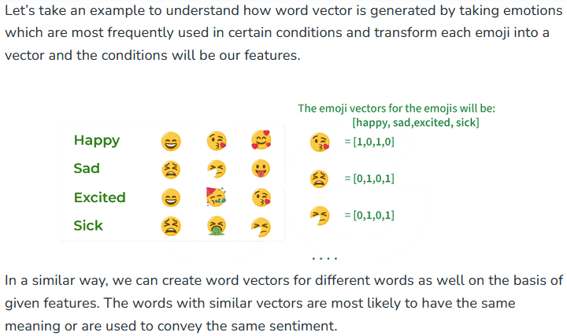

Slide 80
Approaches for Text Representation
1. Traditional Approach
The conventional method involves compiling a list of distinct terms and giving each one a unique integer value, or id. and after that, insert each word’s distinct id into the sentence.
Every vocabulary word is handled as a feature in this instance.
Thus, a large vocabulary will result in an extremely large feature size.
1.1. One-Hot Encoding
1.2. Bag of Word (Bow)
1.3. Term frequency-inverse document frequency (TF-IDF)
2. Neural Approach
2.1. Word2Vec
2.2. Continuous Bag of Words(CBOW)
2.3. Skip-Gram

Slide 81
Pretrained Word-Embedding
Pre-trained word embeddings are representations of words that are learned from large corpora and are made available for reuse in various natural language processing (NLP) tasks.
These embeddings capture semantic relationships between words, allowing the model to understand similarities and relationships between different words in a meaningful way.
GloVe
Fasttext
BERT (Bidirectional Encoder Representations from Transformers)

Slide 82
Considerations for Deploying Word Embedding Models
You need to use the exact same pipeline during deploying your model as were used to create the training data for the word embedding. If you use a different tokenizer or different method of handling white space, punctuation etc. you might end up with incompatible inputs.
Words in your input that doesn’t have a pre-trained vector. Such words are known as Out of Vocabulary Word(oov). What you can do is replace those words with “UNK” which means unknown and then handle them separately.
Dimension mis-match: Vectors can be of many lengths. If you train a model with vectors of length say 400 and then try to apply vectors of length 1000 at inference time, you will run into errors. So make sure to use the same dimensions throughout.

Slide 83
Advantages of Word Embeddings
It is much faster to train than hand build models like WordNet (which uses graph embeddings).
Almost all modern NLP applications start with an embedding layer.
It Stores an approximation of meaning.

Slide 84
Disadvantages of Word Embeddings
It can be memory intensive.
It is corpus dependent. Any underlying bias will have an effect on your model.
It cannot distinguish between homophones. Eg: brake/break, cell/sell, weather/whether etc.

Slide 85
Conclusion
In conclusion, word embedding techniques such as TF-IDF, Word2Vec, and GloVe play a crucial role in natural language processing by representing words in a lower-dimensional space, capturing semantic and syntactic information.

Slide 86
1. Does GPT use word embeddings?
GPT uses context-based embeddings rather than traditional word embeddings.
It captures word meaning in the context of the entire sentence.

Slide 87
2. What is the difference between Bert and word embeddings?
BERT is contextually aware, considering the entire sentence, while traditional word embeddings, like Word2Vec, treat each word independently.

Slide 88
3. What are the two types of word embedding?
Word embeddings can be broadly evaluated in two categories, intrinsic and extrinsic.
For intrinsic evaluation, word embeddings are used to calculate or predict semantic similarity between words, terms, or sentences.

Slide 89
4. How does word vectorization work?
Word vectorization converts words into numerical vectors, capturing semantic relationships.
Techniques like TF-IDF, Word2Vec, and GloVe are common.

Slide 90
5. What are the benefits of word embeddings?
Word embeddings offer semantic understanding, capture context, and enhance NLP tasks.
They reduce dimensionality, speed up training, and aid in language pattern recognition.

Slide 91
Summary
LLMs require textual data to be converted into numerical vectors, known as embeddings, since they can’t process raw text.
Embeddings transform discrete data (like words or images) into continuous vector spaces, making them compatible with neural network operations.
As the first step, raw text is broken into tokens, which can be words or characters.
Then, the tokens are converted into integer representations, termed token IDs.
Special tokens, such as <|unk|> and <|endoftext|>, can be added to enhance the model’s understanding and handle various contexts, such as unknown words or marking the boundary between unrelated texts.

Slide 92
Cont’d
The byte pair encoding (BPE) tokenizer used for LLMs like GPT-2 and GPT-3 can efficiently handle unknown words by breaking them down into subword units or individual characters.
We use a sliding window approach on tokenized data to generate input–target pairs for LLM training.
Embedding layers in PyTorch function as a lookup operation, retrieving vectors corresponding to token IDs. The resulting embedding vectors provide continuous representations of tokens, which is crucial for training deep learning models like LLMs.
While token embeddings provide consistent vector representations for each token, they lack a sense of the token’s position in a sequence.
To rectify this, two main types of positional embeddings exist:
absolute and relative.
OpenAI’s GPT models utilize absolute positional embeddings, which are added to the token embedding vectors and are optimized during the model training.

